Slide 1
Prediction at Village level deep learning based
Anuj
Anupam

Slide 2
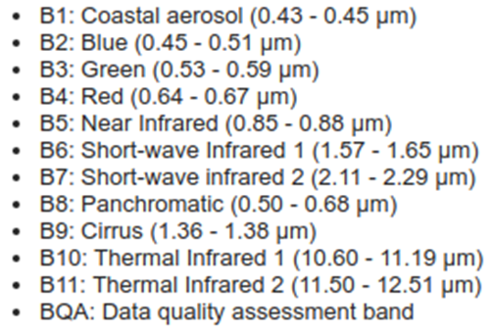
Aim
To view temporal variation over the years as a model of development of villages.
Already tried using nightlight, but aim to use the 12 bands of Landsat and Sentinel for higher accuracy in prediction of labels.
Landsat
Landsat data available from April’13 onwards
We used the data from 01-01-2014 to 12-01-2014,
with the labels of the 2011 Census.
Used RGB Bands with 30m resolution.

Slide 3
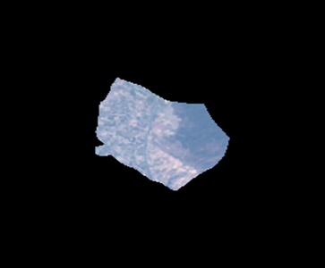
Work currently done
Previously, simple training done on all parameters, without fine tuning or weight balancing, which lead to class imbalance.
Did further improvement in accuracy by fine tuning the model.
Did weight balancing, which lead to improved f1 scores across classes.
Compared these accuracies with much more detailed Sentinel data
(which has a granularity of 10 m vs Landsat’s data of 30 m)
For example, we ran the model for FC (Fuel for cooking).
The accuracies obtained were 73.48%,74.83% and 75.81% for the initial model, the fine-tuned model and Sentinel Data respectively.

Slide 4
Work currently done
Created Working Balanced and Finetuned Models for all parameters using Imagenet weights.
Models based on 3 band RGB layer.
This lead to improved confusion matrix representation.
We also experimented with different pre-trained models for Transfer Learning.
These included InceptionV3, Resnet and Xception models.
Final models obtained for different parameters, according to different transfer learning models.

Slide 5
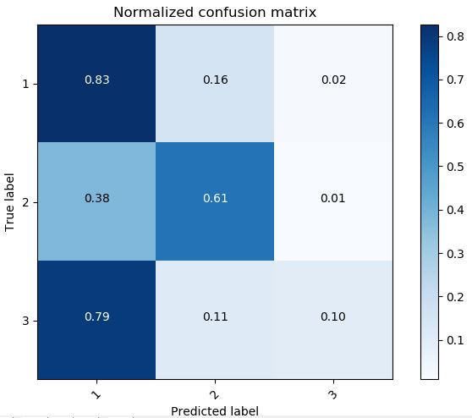
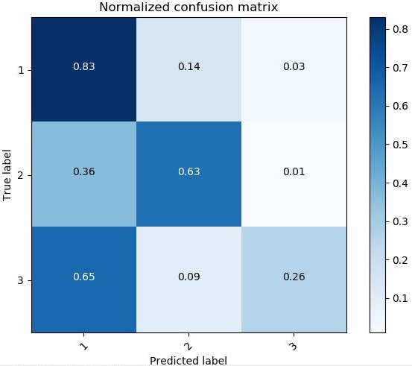
Without Fine Tuning
With Fine Tuning
Labels (for Fuels for cooking)
1 | Under Developed
2 | Moderately Developed
3 | Developed
The confusion matrix shows the positive effect of fine tuning.
The data is skewed – with a distribution of 69%,25% and 6%.
The correct prediction of Developed areas increases with fine tuning.

Slide 6
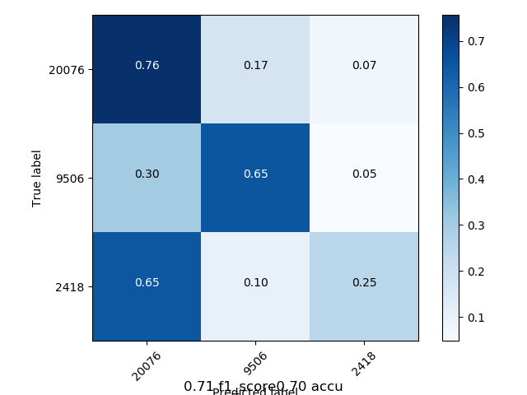
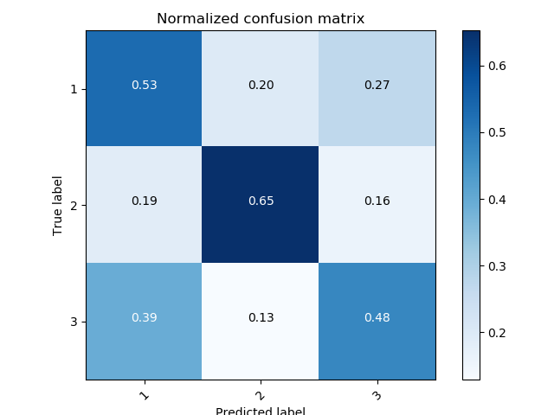
Weight Balancing
Xception
Labels (for Fuels for cooking)
1 | Under Developed
2 | Moderately Developed
3 | Developed

Slide 7
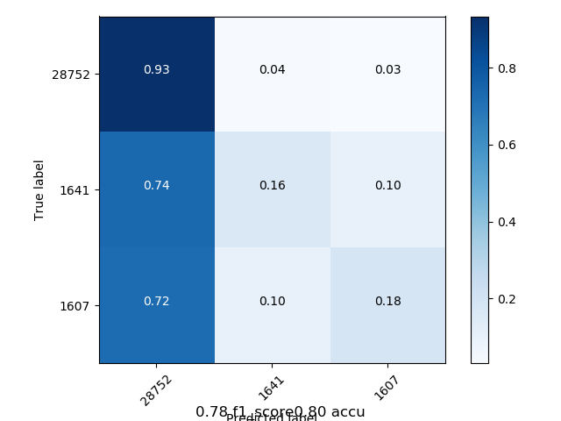
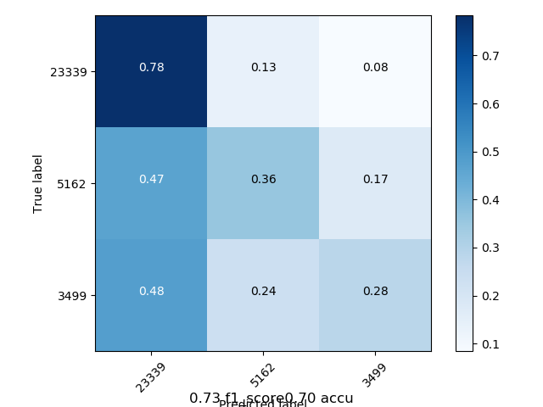
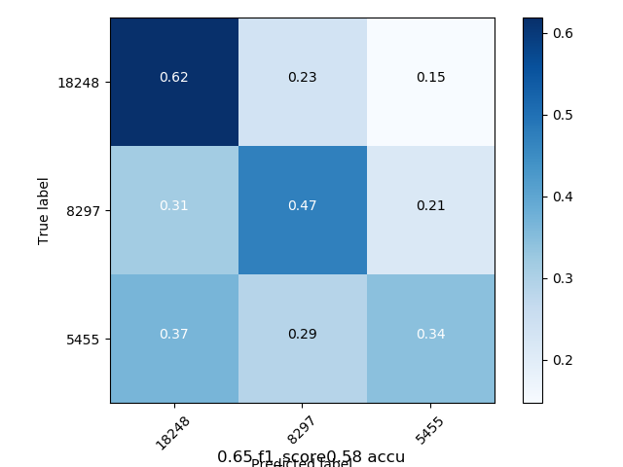
Old Model
Using InceptionV3
Using Xception
Labels (Bathroom Facilities)
1 | Under Developed
2 | Moderately Developed
3 | Developed

Slide 8
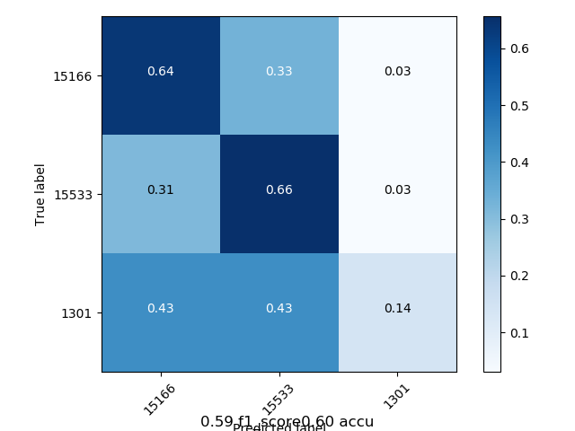
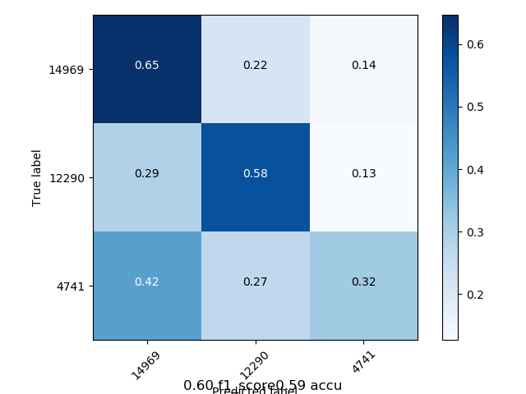
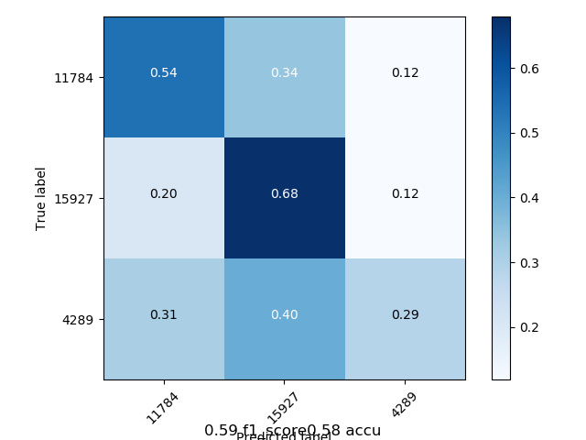
Old Model
Using InceptionV3
Using Xception
Labels (Employment)
1 | Under Developed
2 | Moderately Developed
3 | Developed

Slide 9
Next Steps
Landsat
Using the 12 bands data for LANDSAT 8 for creating a new architecture for better prediction of the labels
(Work already started. Will be using TensorFlow to implement the architecture)
Obtain shape files for more states, train the model on these.
Predict labels and see temporal and spatial variation for other states in India, on a per cluster basis
Use an ensemble model to predict labels by using combination of different models.
Allot label to each cluster on the basis of villages covered in these and gauge accuracy of the models using these labels.

